Slide 1
TELECOM CHURN ANALYSIS:A SYRIA TEL PERSPECTIVE

Slide 2
BUSINESS UNDESTANDING
Stakeholder: SyriaTel, a prominent player in the telecommunications sector, is committed to comprehending and addressing the challenge of customer churn to optimize revenue streams and elevate overall customer satisfaction.
Business Challenge: SyriaTel grapples with a substantial rate of customer churn, where subscribers terminate their services, posing a financial risk. This underscores the necessity of recognizing patterns and elements that contribute to the phenomenon of churn.
Project Goals:
Anticipate whether a customer is inclined to churn in the immediate future. Reveal insights actionable for devising targeted retention strategies. Importance: Mitigating customer churn is pivotal for ensuring a resilient and profitable customer base. Proactively addressing the factors influencing churn empowers SyriaTel to introduce customer-centric initiatives, enhance service quality, and cultivate enduring customer loyalty.
Key Inquiries:
What are the primary drivers of customer churn within the telecom industry? Can we effectively predict customers with the highest likelihood of churning? How can the findings from the analysis guide the implementation of personalized retention strategies? Performance Metrics:
Accuracy in predicting churn/non-churn. Precision and recall metrics to strike a balance between false positives and false negatives. Evaluation of feature importance to pinpoint crucial factors contributing to churn.

Slide 3
Steps followed
Data analysis
Model building and evaluation
Hyper parameter tuning
Conclusion
Recommendation

Slide 4
Data Features
state: state where a customer lives
account length: the number of days the customer has had an account
area code: the area code of the customer
phone number: the phone number of the customer
international plan: true if the customer has the international plan, otherwise false
voice mail plan: true if the customer has the voice mail plan, otherwise false
number vmail messages: the number of voicemails the customer has sent
total day minutes: total number of minutes the customer has been in calls during the day
total day calls: total number of calls the user has done during the day
total day charge: total amount of money the customer was charged by the Telecom company for calls during the day
total eve minutes: total number of minutes the customer has been in calls during the evening
total eve calls: total number of calls the customer has done during the evening
total eve charge: total amount of money the customer was charged by the Telecom company for calls during the evening
total night minutes: total number of minutes the customer has been in calls during the night
total night calls: total number of calls the customer has done during the night
total night charge: total amount of money the customer was charged by the Telecom company for calls during the night
total intl minutes: total number of minutes the user has been in international calls
total intl calls: total number of international calls the customer has done
total intl charge: total amount of money the customer was charged by the Telecom company for international calls
customer service calls: number of calls the customer has made to customer service
churn: true if the customer terminated their contract, otherwise false

Slide 5
Continuation of the data features
total eve minutes: total number of minutes the customer has been in calls during the evening
total eve calls: total number of calls the customer has done during the evening
total eve charge: total amount of money the customer was charged by the Telecom company for calls during the evening
total night minutes: total number of minutes the customer has been in calls during the night
total night calls: total number of calls the customer has done during the night
total night charge: total amount of money the customer was charged by the Telecom company for calls during the night
total intl minutes: total number of minutes the user has been in international calls
total intl calls: total number of international calls the customer has done
total intl charge: total amount of money the customer was charged by the Telecom company for international calls
customer service calls: number of calls the customer has made to customer service
churn: true if the customer terminated their contract, otherwise false

Slide 6
DATA ANALYSIS

Slide 7
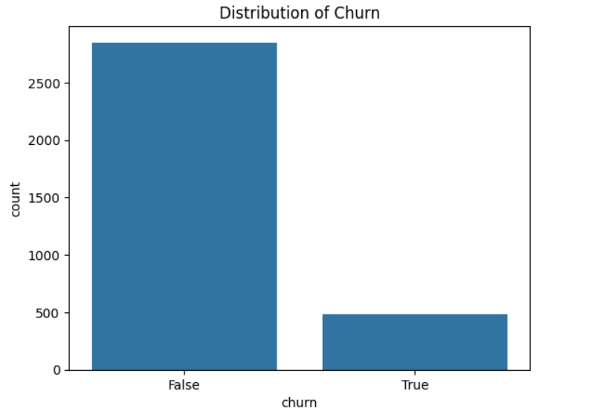
Distribution of churn

Slide 8
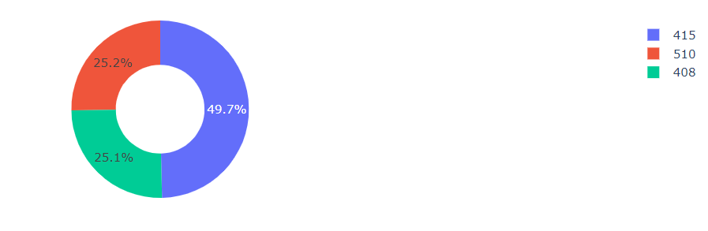
Analysis on "area code"

Slide 9
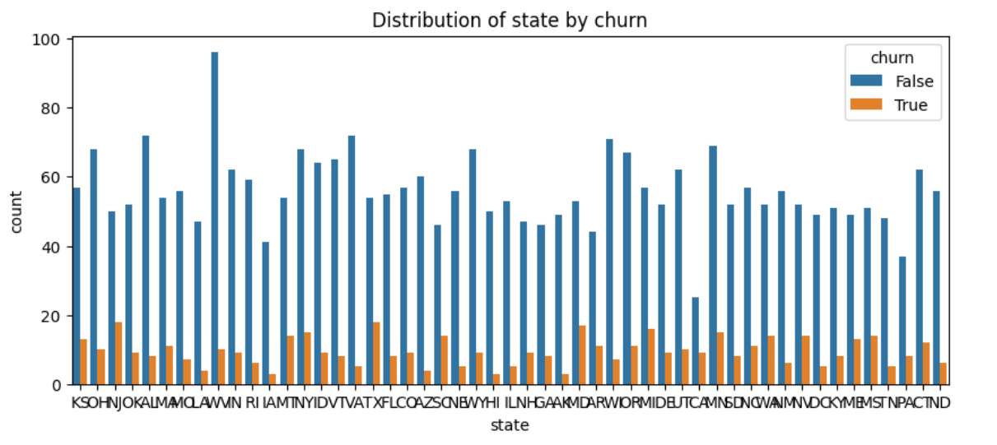
Analysis of the feature "churn"

Slide 10
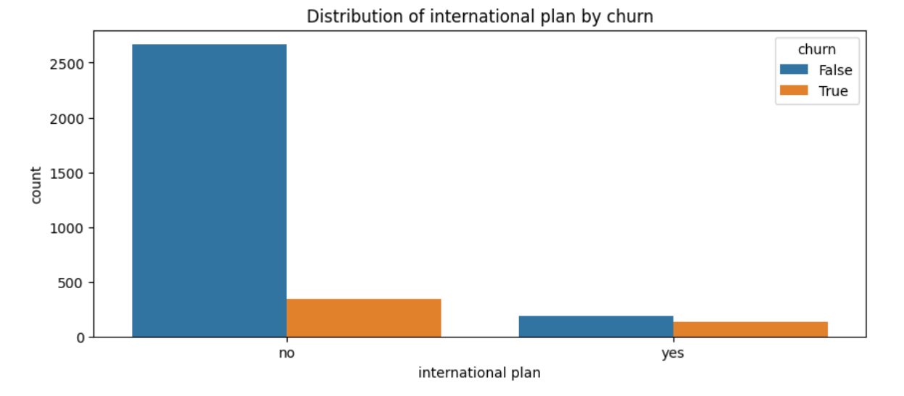

Slide 11
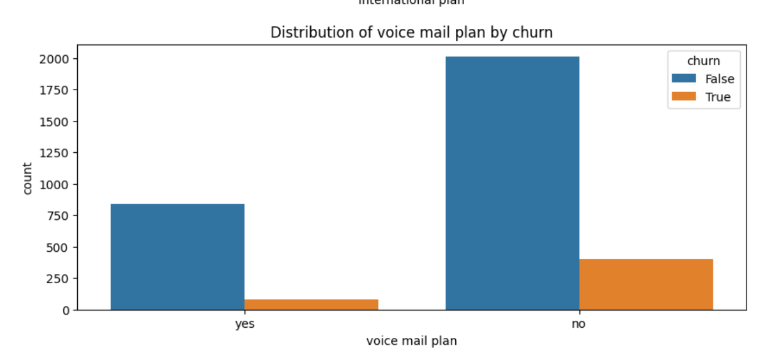

Slide 12
MODEL BUILDING & EVALUATION
dt: Decision Tree Classifier
knn: K-neighbors Classifier
rf: Random Forest Classifier

Slide 13
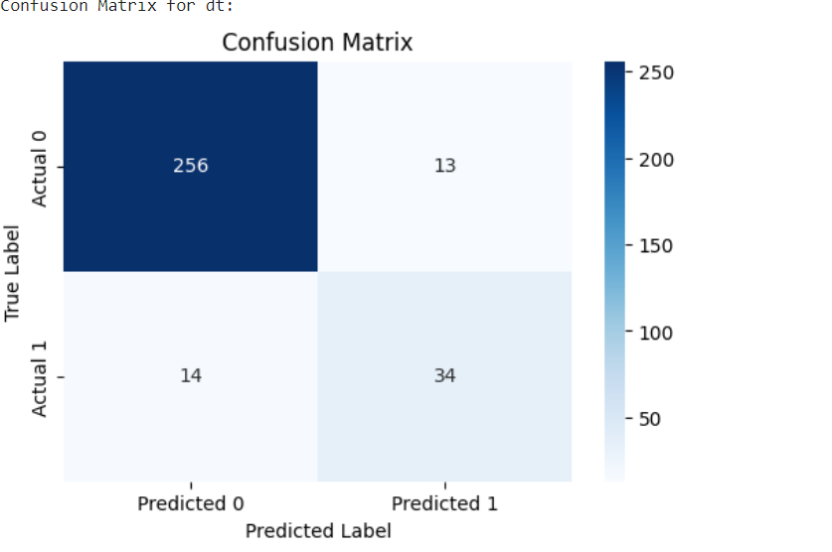
Confusion matrix for dt

Slide 14
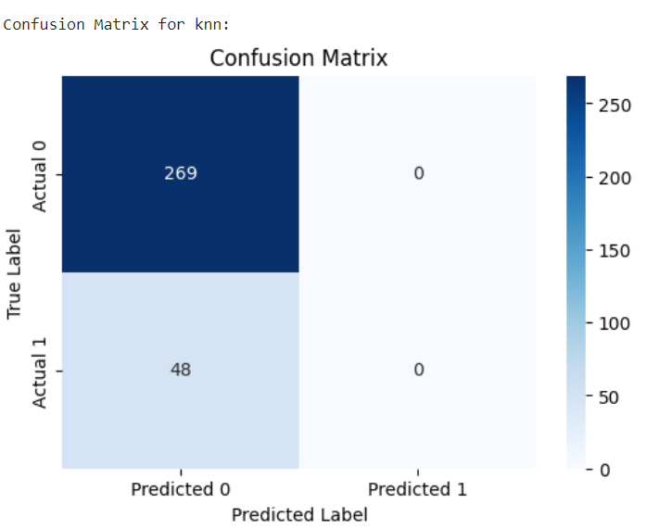
Confusion matrix for knn

Slide 15
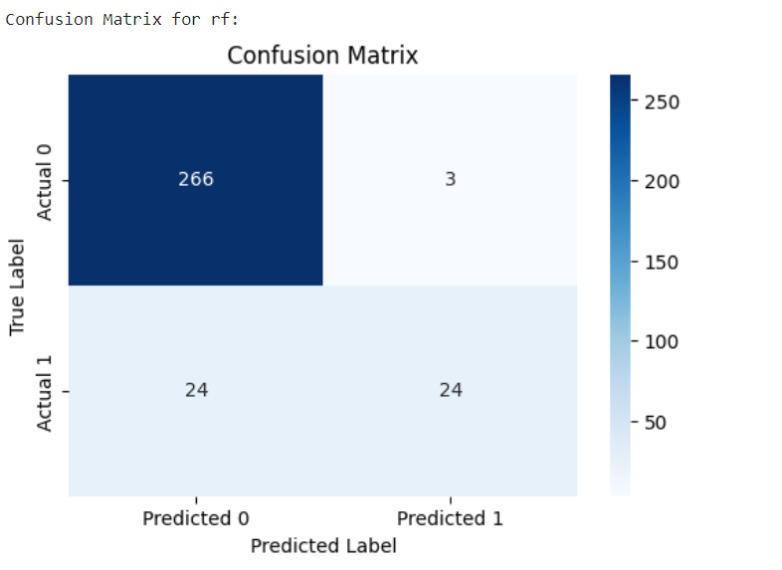
Confusion matrix for rf

Slide 16
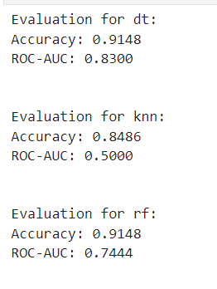

Slide 17
Interpretation:
Decision Tree (dt):The model achieved a high accuracy of 91.80%, indicating that it correctly classified a large portion of the instances.The ROC-AUC score of 83.19% suggests good discrimination performance.K-Nearest Neighbors (knn):The accuracy is 84.86%, indicating reasonable performance, but it's lower than the Decision Tree.The ROC-AUC score is 50.00%, suggesting that the model's discrimination performance is close to random chance. This might indicate an issue with the chosen k value or the suitability of the KNN algorithm for your dataset.Random Forest (rf):The model achieved a high accuracy of 93.06%, which is the highest among the three models.The ROC-AUC score of 79.65% indicates good discrimination performance but is slightly lower than the Decision Tree.

Slide 18
HYPERPARAMETER TUNING

Slide 19
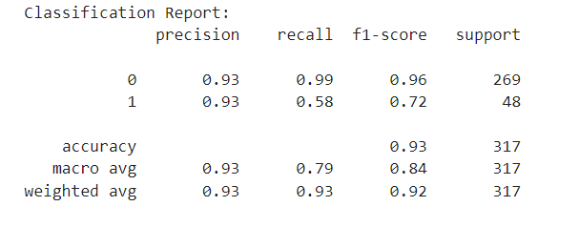

Slide 20
Interpretation
The classification report shows that the model performs well on both classes, with high precision, recall, and F1-score for class 0. The performance for class 1 is also reasonable.
The overall accuracy of 93% on the test set is a positive outcome, indicating the model's effectiveness in making correct predictions.

Slide 21
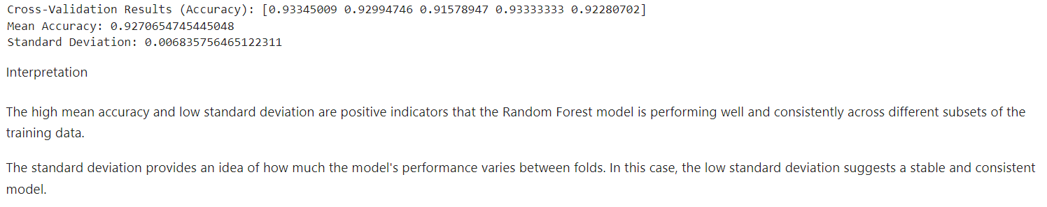
Cross validation

Slide 22
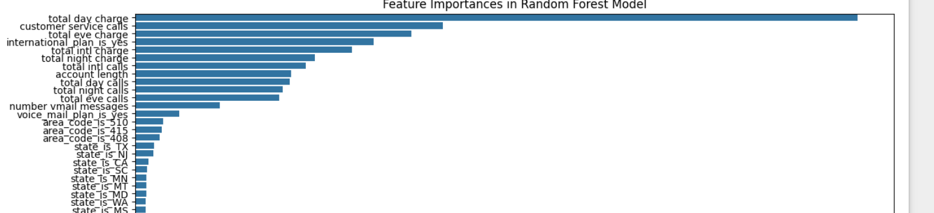
Feature Importance Analysis

Slide 23
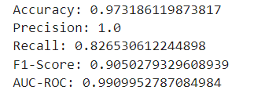
Reassessing the performance of a model after addressing class imbalance

Slide 24
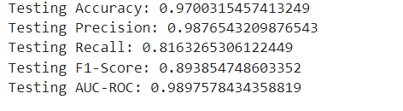
Testing set using Python and scikit-learn

Slide 25
Conclusion
The Random Forest model appears to excel in terms of accuracy and F1-score when compared to the other two models. It is crucial to consider both precision and recall, especially in accordance with the specific requirements of the business problem at hand. The model demonstrates robust adaptability to fresh, unseen data, evident in its elevated testing accuracy, precision, recall, and AUC-ROC. It maintains a notable precision level, minimizing false positives—a critical aspect for SyriaTel in mitigating the financial risks linked to customer churn. Additionally, the model exhibits strong recall, effectively identifying a substantial portion of genuine churn cases. The F1-Score contributes to a well-balanced perspective, considering both precision and recall. In conclusion, the machine learning model, based on the testing outcomes, appears to adeptly address SyriaTel's business challenge regarding customer churn

Slide 26
Recommendation
Explore the option of deploying the model in a live environment for immediate predictions. Establish monitoring systems to continuously assess the model's performance over the course of time. Engage with stakeholders to incorporate the model's predictions into focused retention strategies. Persist in refining and enhancing the model based on continuous feedback and evolving trends in the telecommunications industry.

